Slide 1
Towards a scalable multiscale analysis of geophysical data Illia Horenko (USI Lugano)
Literature:
[1] S. Gerber, I. Horenko, On inference of causality for discrete state models in a multiscale context, Proceedings of the National Academy of Sciences of USA (PNAS), 111(41): 14651-14656, 2014.
[2] S. Gerber, I. Horenko, Improving clustering by imposing network information, Science Advances (AAAS),1(7): e1500163, 2015.
[3] S. Gerber, I. Horenko, Towards a direct and scalable identification of reduced models for categorical processes, Proceedings of the National Academy of Sciences of USA (PNAS), 114(19): 4863-4868, 2017.
[4] L. Pospisil, P. Gagliardini, W. Sawyer, I. Horenko, On a scalable nonparametric denoising of time series signals, Communications in Applied Mathematics and Computational (CAMCoS), 13(1): 107-138, 2018.
[5] S. Gerber, S. Olsson, F. Noé, I. Horenko, A scalable approach to the computation of invariant measures for high-dimensional Markovian systems, Nature Scientific Reports, 8(1): 1796-1806, 2018.

Slide 2
Main Motivation: disentangling errors in data-driven dynamic models
model
error
Errors
representation/
discretization
error
estimation
error
Typical machine learning approaches like multilinear regression, Stochastic Differential Equations (SDEs) and Neuronal Networks (NNs) are subject to a mixture of all three error types

Slide 3
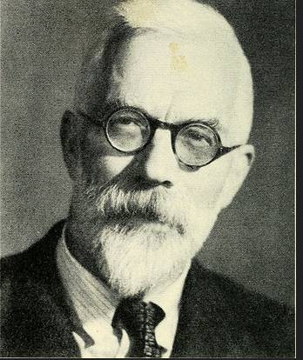
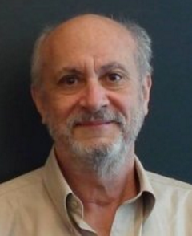
Motivation: Model-Error-free Bayesian Graphs and Models (Fisher‘25, Rubin’72-...,Holland’86 -…)
General task: understanding a relation between the variables X^{t} and Y^{t}, t=1,...,S
Fluid mechanics: t is a space-time multi-index, X^{t} is some flow variable,
Y^{t} is another flow variable
Molecular dynamics: t is time, X^{t} is a molecular state at time t, Y^{t}=X^{t+1}
Exact Law of the Total Probability in a matrix notation:
Relation to graphs/networks:
Y^{t}=X^{t+1} is a particular case of a time- and space-discrete Markov model
Sir Ronald Fisher
Figures from wiki.org
Donald Rubin
π_{Y}(t)
Λ
π_{X}(t)
P[Y^{t}=y₁]
P[Y^{t}=y₂]
…
P[Y^{t}=y_{m}]
P[Y^{t}=y₁|X^{t}=x₁] | P[Y^{t}=y₁|X^{t}=x₂] | … | P[Y^{t}=y₁|X^{t}=x_{n}]
P[Y^{t}=y₂|X^{t}=x₁] | P[Y^{t}=y₂|X^{t}=x₂] | … | P[Y^{t}=y₂|X^{t}=x_{n}]
… | … | … | …
P[Y^{t}=y_{m}|X^{t}=x₁] | P[Y^{t}=y_{m}|X^{t}=x₂] | … | P[Y^{t}=y_{m}|X^{t}=x_{n}]
P[X^{t}=x₁]
P[X^{t}=x₂]
…
P[X^{t}=x_{n}]
=
✖
Node x_{j}
Node y_{i}
Edge P[Y=y_{i}|X=x_{j}]

Slide 4
Example: coin flipping
Λ₁₁=P[X^{t+1}=1|X^{t}=1]
1=‘heads’
Λ₂₁=P[X^{t+1}=0|X^{t}=1]
Λ₁₂=P[X^{t+1}=1|X^{t}=0]
0=‘tails’
Λ₂₂=P[X^{t+1}=0|X^{t}=0]
X^{t+1}
X^{t}
P[X^{t+1}=1]
P[X^{t+1}=0]
=
Λ₁₁ | Λ₁₂
Λ₂₁ | Λ₂₂
P[X^{t}=1]
P[X^{t}=0]
✖
Collect a series of observation pairs (X^{t+1},X^{t}): e.g., {(0, 0);(1,0);(1,1);(0,1);(1,0);.....}
Estimate Λ_{ij} from these observations (e.g., with maximum log-likelihood)

Slide 5
Example: coin flipping
Λ₁₁=P[X^{t+1}=1|X^{t}=1]
1=‘heads’
Λ₂₁=P[X^{t+1}=0|X^{t}=1]
Λ₁₂=P[X^{t+1}=1|X^{t}=0]
0=‘tails’
Λ₂₂=P[X^{t+1}=0|X^{t}=0]
X^{t+1}
X^{t}
P[X^{t+1}=1]
P[X^{t+1}=0]
=
0.5 | 0.5
0.5 | 0.5
P[X^{t}=1]
P[X^{t}=0]
✖
a fair coin
Collect a series of observation pairs (X^{t+1},X^{t}): e.g., {(0, 0);(1,0);(1,1);(0,1);(1,0);.....}
Estimate Λ_{ij} from these observations (e.g., with maximum log-likelihood)

Slide 6
Λ-Estimation and Uncertainty Quantification (UQ)
(*)
(**)
Gerber/Horenko, “Toward a direct and scalable identification of reduced models for categorical processes”, PNAS 114(19), 2017

Slide 7
Example: flipping d coins
n=2^{d}
…
coin 1
P[Y^{t+1}=1|X^{t}={1,…,1}]
X^{t}={1,1,…,1}
1
…
P[Y^{t+1}=0|X^{t}={1,…,1}]
…
coin 2
…
…
…
…
0
P[Y^{t+1}=1|X^{t}={0,…,0}]
X^{t}={0,0,…,0}
…
Y^{t+1}
coin d
X^{t}={1,1,…,1}
X^{t}={1,0,…,1}
X^{t}={0,0,…,0}

Slide 8
Example: flipping d coins
n=2^{d}
coin 1
…
coin 1
P[Y^{t+1}=1|X^{t}={1,…,1}]
X^{t}={1,1,…,1}
1
…
P[Y^{t+1}=0|X^{t}={1,…,1}]
…
coin 2
…
…
…
…
0
P[Y^{t+1}=1|X^{t}={0,…,0}]
X^{t}={0,0,…,0}
…
Y^{t+1}
coin d
X^{t}={1,1,…,1}
X^{t}={1,0,…,1}
X^{t}={0,0,…,0}
P[Y^{t}=y₁|X^{t}=x₁] | P[Y^{t}=y₁|X^{t}=x₂] | … | P[Y^{t}=y₁|X^{t}=x_{n}]
P[Y^{t}=y₂|X^{t}=x₁] | P[Y^{t}=y₂|X^{t}=x₂] | … | P[Y^{t}=y₂|X^{t}=x_{n}]
… | … | … | …
P[Y^{t}=y_{m}|X^{t}=x₁] | P[Y^{t}=y_{m}|X^{t}=x₂] | … | P[Y^{t}=y_{m}|X^{t}=x_{n}]
P[X^{t}=x₁]
P[X^{t}=x₂]
…
P[X^{t}=x_{n}]
P[Y^{t+1}=1]
P[Y^{t+1}=0]
=
✖
n=2^{d}

Slide 9
Λ-Estimation and Uncertainty Quantification (UQ)
(*)
(**)
Gerber/Horenko, “Toward a direct and scalable identification of reduced models for categorical processes”, PNAS 114(19), 2017

Slide 10
Λ-Estimation and Uncertainty Quantification (UQ)
(*)
(**)
“Curse of dimension”
Gerber/Horenko, “Toward a direct and scalable identification of reduced models for categorical processes”, PNAS 114(19), 2017

Slide 11
Example: flipping multiscale coins
…
observed
coin 1
^
X^{t}={1,1,…,1}
P[Y^{t+1}=1|X^{t},X^{t}={1,…,1}]
…
observed
coin 2
1
…
^
Resolved Scales
…
P[Y^{t+1}=0|X^{t},X^{t}={1,…,1}]
…
…
…
observed
coin d
…
0
X^{t}={1,1,…,1}
X^{t}={1,0,…,1}
X^{t}={0,0,…,0}
^
X^{t}={0,0,…,0}
P[Y^{t+1}=0|X^{t},X^{t}={0,…,0}]
Y^{t+1}
…
latent
coin 1
Latent Scales
…
…
…
^
^
^
^
^
^
X^{t}=x(1)
X^{t}=x(2)
X^{t}=x(K)

Slide 12
Example: flipping multiscale coins
…
observed
coin 1
^
X^{t}={1,1,…,1}
P[Y^{t+1}=1|X^{t},X^{t}={1,…,1}]
…
observed
coin 2
1
…
^
Resolved Scales
…
P[Y^{t+1}=0|X^{t},X^{t}={1,…,1}]
…
…
…
observed
coin d
…
0
X^{t}={1,1,…,1}
X^{t}={1,0,…,1}
X^{t}={0,0,…,0}
^
X^{t}={0,0,…,0}
P[Y^{t+1}=0|X^{t},X^{t}={0,…,0}]
Y^{t+1}
…
latent
coin 1
Latent Scales
π_{Y}(t) = Λπ_{X}(t)
…
…
…
^
^
^
^
^
^
→
→
X^{t}=x(1)
X^{t}=x(2)
X^{t}=x(K)
→
^
^
^
^
→
Y^{t} {y(1),y(2),...,y(m)}
X^{t} {x(1),x(2),...,x(n)}
X^{t} {x(1),x(2),...,x(K)}
→
→
→
→
reduced/latent Bayesian models
(Th. Hoffman, ‘99,’01)

Slide 13
Example: flipping multiscale coins
…
observed
coin 1
^
X^{t}={1,1,…,1}
P[Y^{t+1}=1|X^{t},X^{t}={1,…,1}]
…
observed
coin 2
1
…
^
Resolved Scales
…
P[Y^{t+1}=0|X^{t},X^{t}={1,…,1}]
…
…
…
observed
coin d
…
0
X^{t}={1,1,…,1}
X^{t}={1,0,…,1}
X^{t}={0,0,…,0}
^
X^{t}={0,0,…,0}
P[Y^{t+1}=0|X^{t},X^{t}={0,…,0}]
Y^{t+1}
…
latent
coin 1
Latent Scales
π_{Y}(t) = Λπ_{X}(t)
…
…
…
^
^
^
^
^
^
→
→
X^{t}=x(1)
X^{t}=x(2)
X^{t}=x(K)
→
^
^
^
^
→
Y^{t} {y(1),y(2),...,y(m)}
X^{t} {x(1),x(2),...,x(n)}
X^{t} {x(1),x(2),...,x(K)}
…
…
→
→
K=1
independent
X and Y
1<K<n
latent
models
K=n
common Bayesian
model
→
→
reduced/latent Bayesian models
(Th. Hoffman, ‘99,’01)
Gerber/Horenko, PNAS 114(19), 2017

Slide 14
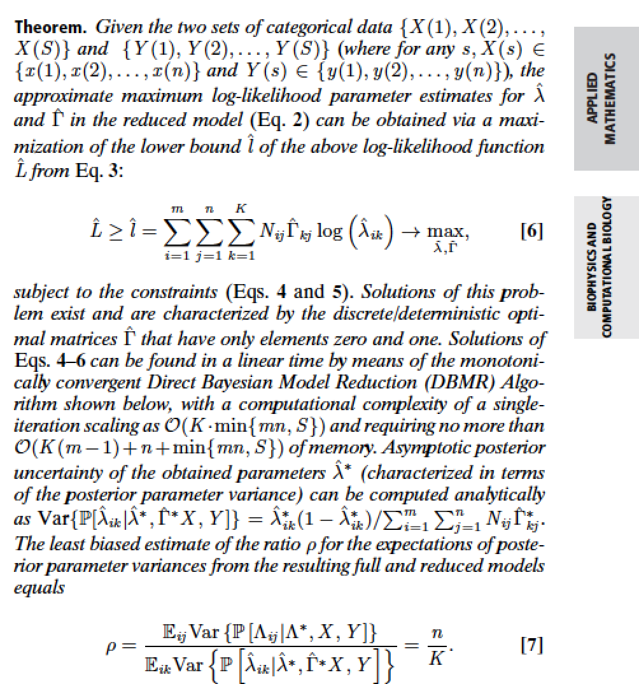
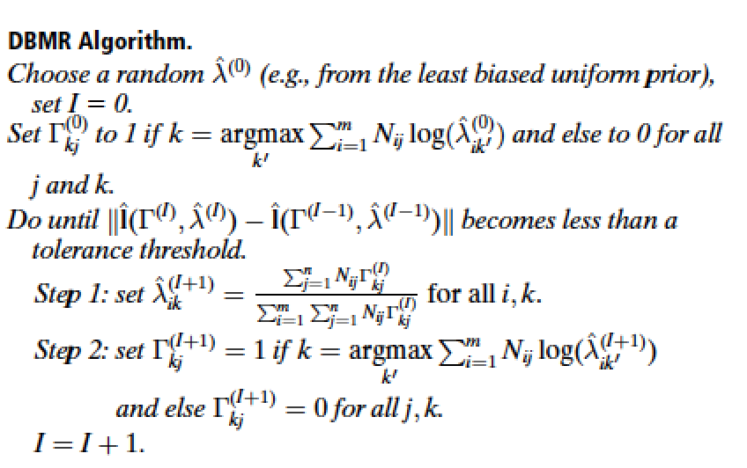
Direct Data-Driven Inference of Exact Reduced Bayesian Models
Sparse Direct Bayesian Model Reduction (DBMR, G./Horenko‘17)
Idea: in the class of all low-rank models, try to find only those that are sparse.
Notes:
The “trick“ that allows us to resoive the “curse of dimension“ problem for non-sparse system: we are looking only for the sparse reduced models that are as close as possible to the best possible reduced models. Blue curve below shows that the quality of this sparse approximation gets better with the growing dimension of Y

Slide 15
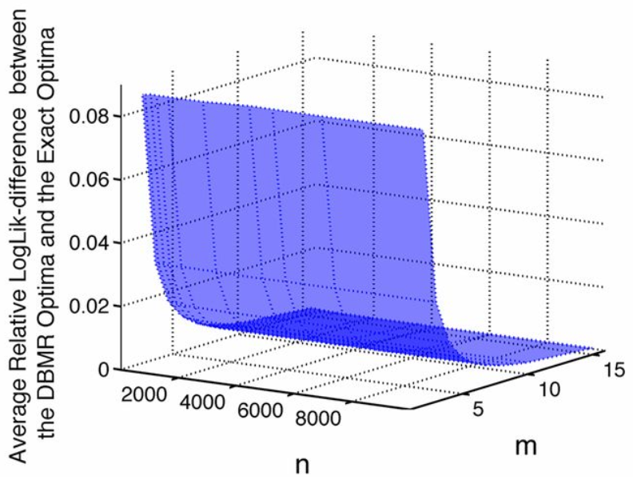
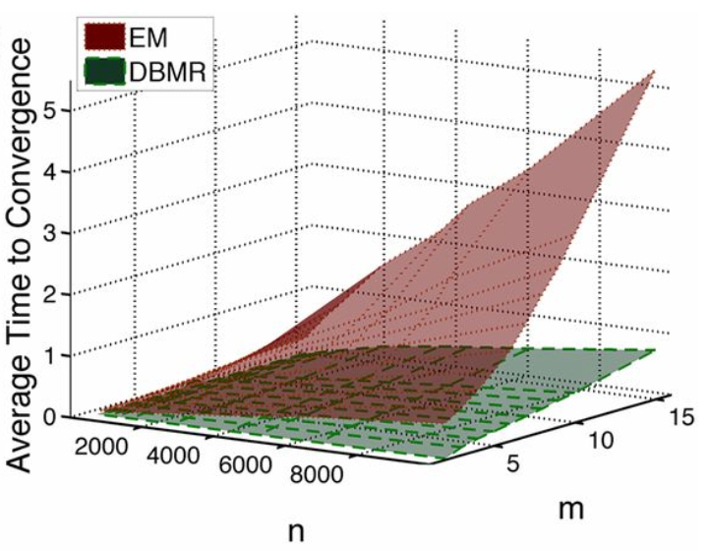
Direct Data-Driven Inference of Exact Reduced Bayesian Models
Sparse Direct Bayesian Model Reduction (DBMR, G./Horenko‘17)
Idea: in the class of all low-rank models, try to find only those that are sparse.
Comparison to the Hofmann‘s Expectation-Maximisation-algorithm (Th. Hofmann‘99)
On a PC, computation for a realistic system (n=m~10⁵) with DBMR algorithm takes ~30 minutes, with EM 1’400 years
Gerber/Horenko, PNAS 114(19), 2017
Notes:
The “trick“ that allows us to resoive the “curse of dimension“ problem for non-sparse system: we are looking only for the sparse reduced models that are as close as possible to the best possible reduced models. Blue curve below shows that the quality of this sparse approximation gets better with the growing dimension of Y

Slide 16
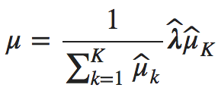
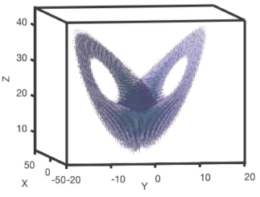
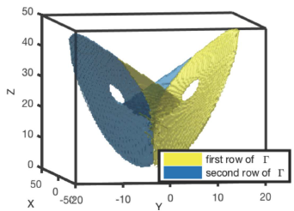
Implication: cheaper computation of Markov observables
Given a reduced K-dimensional Markov model , computation of the Markovian invariant measure costs additionally O(K³+n²), cost of the common computation is O(n³):
Example: Lorenz-63 model
Gerber/Olsson/Noe/Horenko, Nat.Sci.Rep. 8:1796, 2018
Notes:
The “trick“ that allows us to resoive the “curse of dimension“ problem for non-sparse system: we are looking only for the sparse reduced models that are as close as possible to the best possible reduced models. Blue curve below shows that the quality of this sparse approximation gets better with the growing dimension of Y

Slide 17
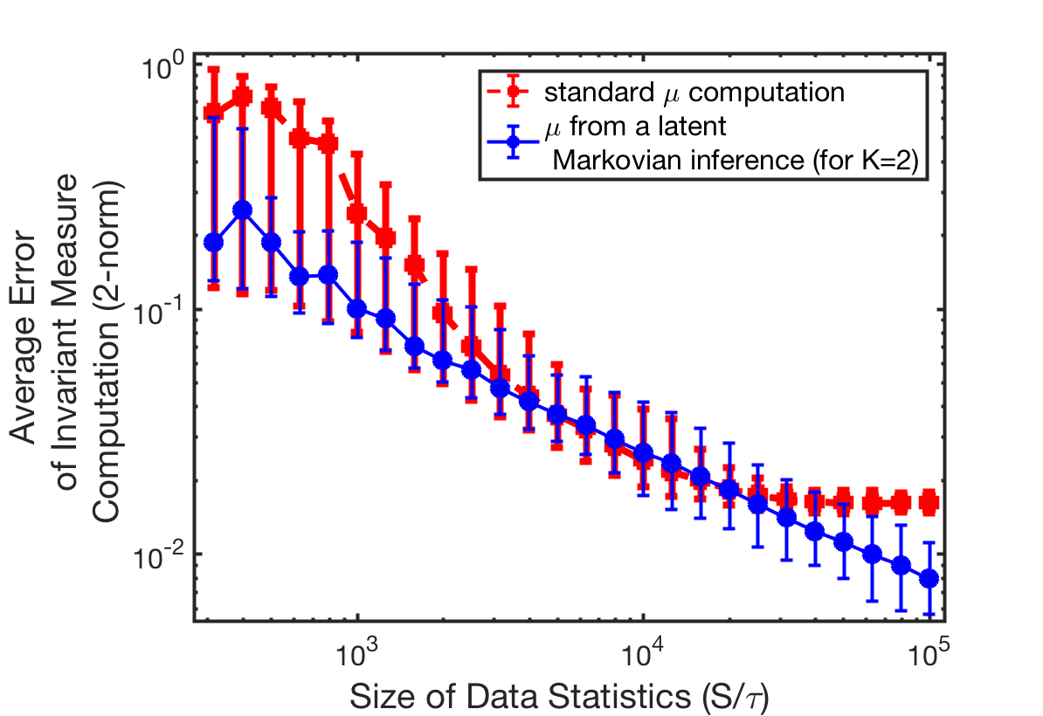
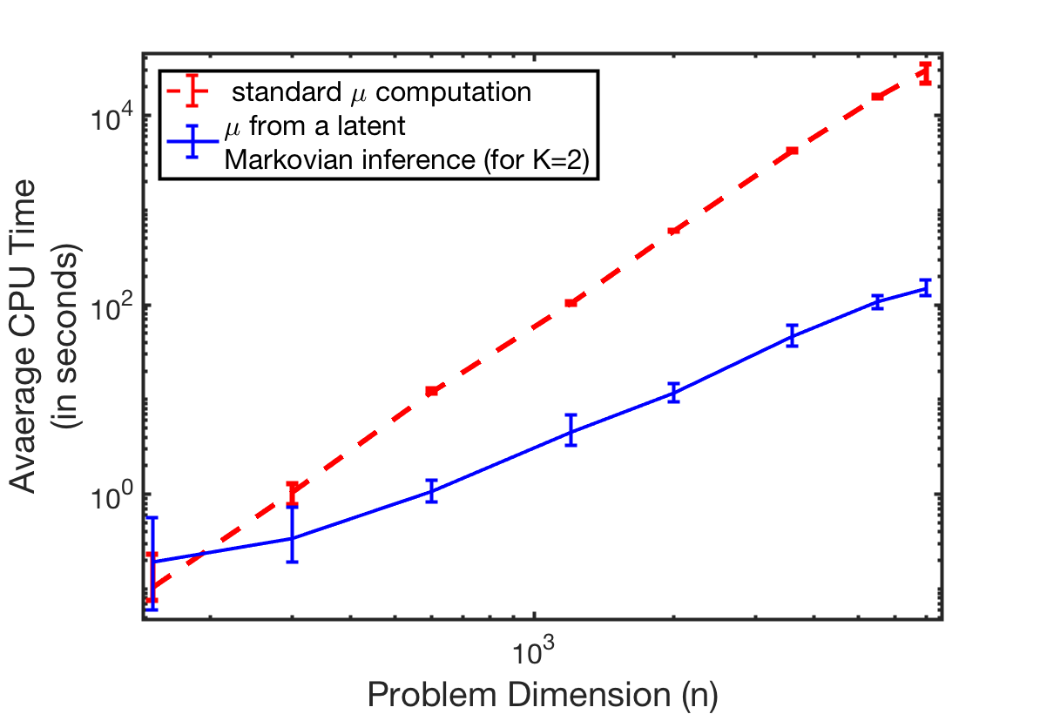
Implication: cheaper computation of Markov observables
Given a reduced K-dimensional Markov model , computation of the Markovian invariant measure costs additionally O(K³+n²), cost of the common computation is O(n³):
Example: Lorenz-63 model
Gerber/Olsson/Noe/Horenko, Nat.Sci.Rep. 8:1796, 2018
Notes:
The “trick“ that allows us to resoive the “curse of dimension“ problem for non-sparse system: we are looking only for the sparse reduced models that are as close as possible to the best possible reduced models. Blue curve below shows that the quality of this sparse approximation gets better with the growing dimension of Y

Slide 18
Motivation: disentangling the errors in data-driven dynamic models
model
error
Errors
representation/discretization
error
estimation
error

Slide 19
What about the impact of discretization errors?
model
error
Errors
representation/
discretization
error
estimation
error

Slide 20
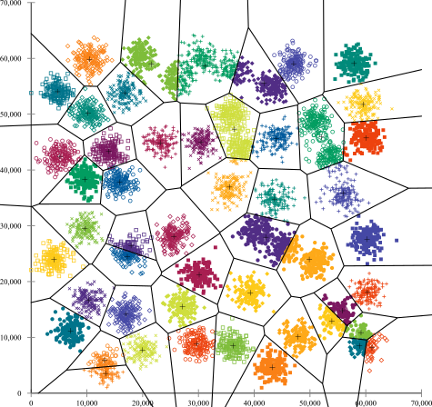
Classification of Data-Discretization Methods
Box-discretization (e.g., previous Lorenz-63 example) →applicable only to problems with few dimensions only
Clustering-based discretization (using Voronoi cells and K-means): , HMM/GMM (Baum‘69), K-means (Hartigan’71),PCCA+(Deuflhard/Weber‘03-...), TICA (Noe et.al. 13‘-...)

Slide 21
Classification of Data-Discretization Methods
Box-discretization (e.g., previous Lorenz-63 example) →applicable only to problems with few dimensions only
Clustering-based discretization (using Voronoi cells and K-means): , HMM/GMM (Baum‘69), K-means (Hartigan’71),PCCA+(Deuflhard/Weber‘03-...), TICA (Noe et.al. 13‘-...)
Main advantage: cost scales as O(n)+O(T)
Main potential disadvantages: ill-posednes and violation of Markovianity

Slide 22
FEM-based Data Analysis Framework
g(...,...) – model error
x_{t} –data
θ(…)-parameters, γ_{t}-discretization
Notes:
Note the difference with Bayesian learning
Straightforwadly generalizable for cases when θ and γ are functions of more then one argument
2. Nice link to graph-theory → not enough time → ask me later

Slide 23
FEM-based Data Analysis Framework
g(...,...) – model error
x_{t} –data
θ(…)-parameters, γ_{t}-discretization
Notes:
Note the difference with Bayesian learning
Straightforwadly generalizable for cases when θ and γ are functions of more then one argument
2. Nice link to graph-theory → not enough time → ask me later

Slide 24
FEM-based Data Analysis Framework
g(...,...) – model error
x_{t} –data
θ(…)-parameters, γ_{t}-discretization
H₁ regularization (|θ(•)|_{H1}≤ C) → sequence of sparse Quadratic Programming problems
BV-regularization (|θ(•)|_{BV}≤ C) → sequence of sparse Linear Programming problems
Horenko; SIAM J. of Sci. Comp., 32(1):62–83, 2010
Horenko; SIAM Mult. Mod. Sim, 9(4):1700-1726, 2011
Horenko; DYNAT, 49(2-3):164–187, 2010
Horenko; J. Atm. Sci., 67(5):1559–1574, 2010.
Metzner/Putzig/Horenko; CAMCOS, 7(2), 175-229, 2012.
Notes:
Note the difference with Bayesian learning
Straightforwadly generalizable for cases when θ and γ are functions of more then one argument
2. Nice link to graph-theory → not enough time → ask me later

Slide 25
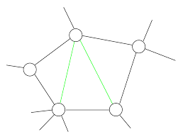
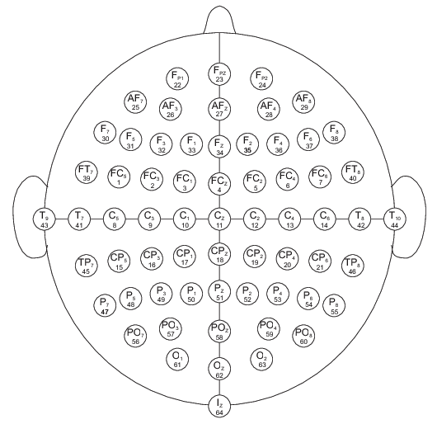
FEM-based Data Analysis Framework
g(...,...) – model error
x_{t} –data
θ(…)-parameters, γ_{t}-discretization
H₁ regularization (|θ(•)|_{H1}≤ C) → sequence of sparse Quadratic Programming problems
BV-regularization (|θ(•)|_{BV}≤ C) → sequence of sparse Linear Programming problems
From time series data to data on graphs and networks → graph-induced regularization
Horenko; SIAM J. of Sci. Comp., 32(1):62–83, 2010
Horenko; SIAM Mult. Mod. Sim, 9(4):1700-1726, 2011
Horenko; DYNAT, 49(2-3):164–187, 2010
Horenko; J. Atm. Sci., 67(5):1559–1574, 2010.
Metzner/Putzig/Horenko; CAMCOS, 7(2), 175-229, 2012.
graph-persistent/metastable models
time-persistent/metastable models
t
…
…
t_{n-2}
t_{n-1}
t_{n}
t_{n+1}
t_{n+2}
time
Regularization: parameter values of θ(t) should be similar if they are close in time
Regularization: parameter values of θ(s) should be similar if they are close on the graph
Gerber/Horenko; Science Advances (AAAS), 1(7):e1500163, 2015
Notes:
Note the difference with Bayesian learning
Straightforwadly generalizable for cases when θ and γ are functions of more then one argument
2. Nice link to graph-theory → not enough time → ask me later

Slide 26
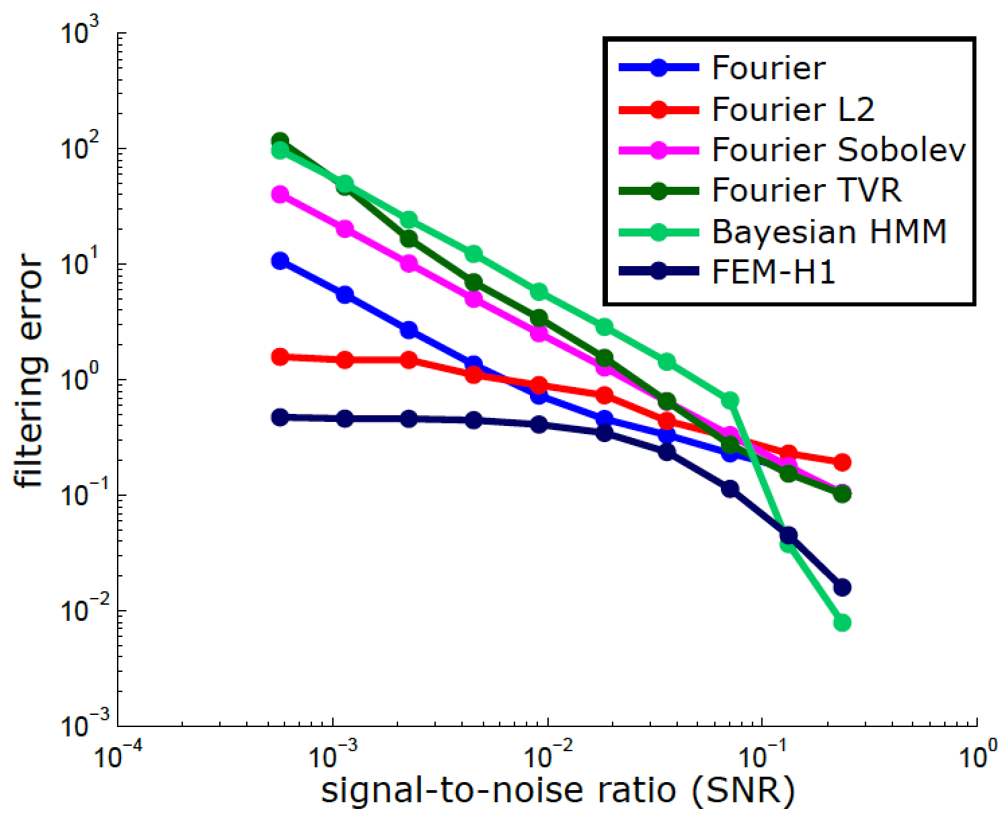
FEM-based Data Analysis Framework
g(...,...) – model error
x_{t} –data
θ(…)-parameters, γ_{t}-discretization
H₁ regularization (|θ(•)|_{H1}≤ C) → sequence of sparse Quadratic Programming problems
BV-regularization (|θ(•)|_{BV}≤ C) → sequence of sparse Linear Programming problems
From time series data to data on graphs and networks → graph-induced regularization
From small data (up to 20‘000 data points) to
BIG DATA (10⁷-10⁸ points): using the algebraic
structure for numerics→outperforms all common
denoising methods for large noises
Horenko; SIAM J. of Sci. Comp., 32(1):62–83, 2010
Horenko; SIAM Mult. Mod. Sim, 9(4):1700-1726, 2011
Horenko; DYNAT, 49(2-3):164–187, 2010
Horenko; J. Atm. Sci., 67(5):1559–1574, 2010.
Metzner/Putzig/Horenko; CAMCOS, 7(2), 175-229, 2012.
graph-persistent/metastable models
time-persistent/metastable models
t
…
…
t_{n-2}
t_{n-1}
t_{n}
t_{n+1}
t_{n+2}
time
Regularization: parameter values of θ(t) should be similar if they are close in time
Regularization: parameter values of θ(s) should be similar if they are close on the graph
Gerber/Horenko; Science Advances (AAAS), 1(7):e1500163, 2015
Pospisil/Gagliardini/Sawyer/Horenko; CAMCOS, 13(1), 2018
Notes:
Note the difference with Bayesian learning
Straightforwadly generalizable for cases when θ and γ are functions of more then one argument
2. Nice link to graph-theory → not enough time → ask me later

Slide 27
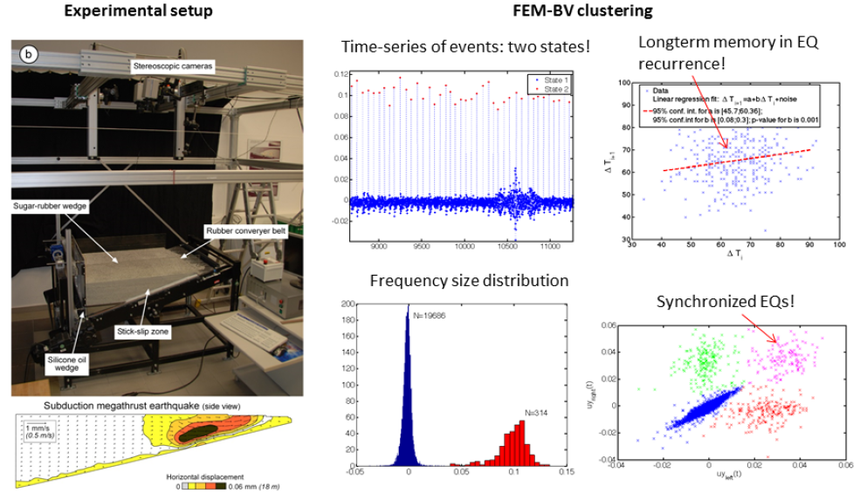
FEM-discretization example: non-stationary analysis of analog earthquakes data
Rosenau/Horenko/Corbi/Rudolf/Kornhuber/Oncken, 2017, CRC1114: 2145
Notes:
Note the difference with Bayesian learning
Straightforwadly generalizable for cases when θ and γ are functions of more then one argument
2. Nice link to graph-theory → not enough time → ask me later

Slide 28
What about the impact of discretization errors?
model
error
Errors
representation/discretization
error
estimation
error

Slide 29
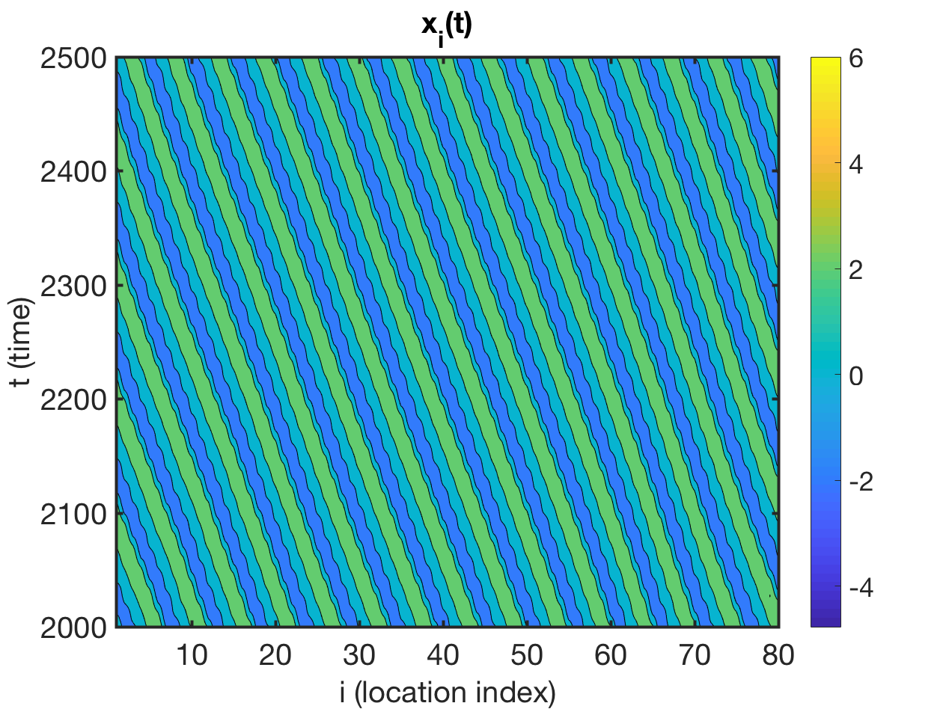
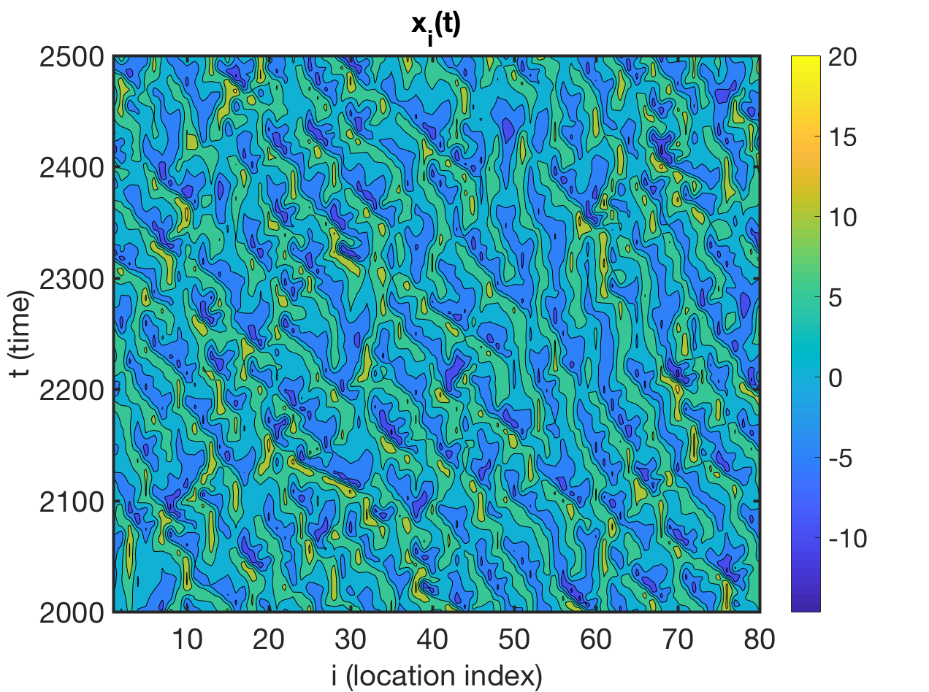
Lorenz-96 Model (“1D turblence“)
F=4
F=12
Data pre-processing: time step resolution 0.02, Takens embedding (3n) to guarantee Markovianity→ 80*3=240 dimensional problem

Slide 30
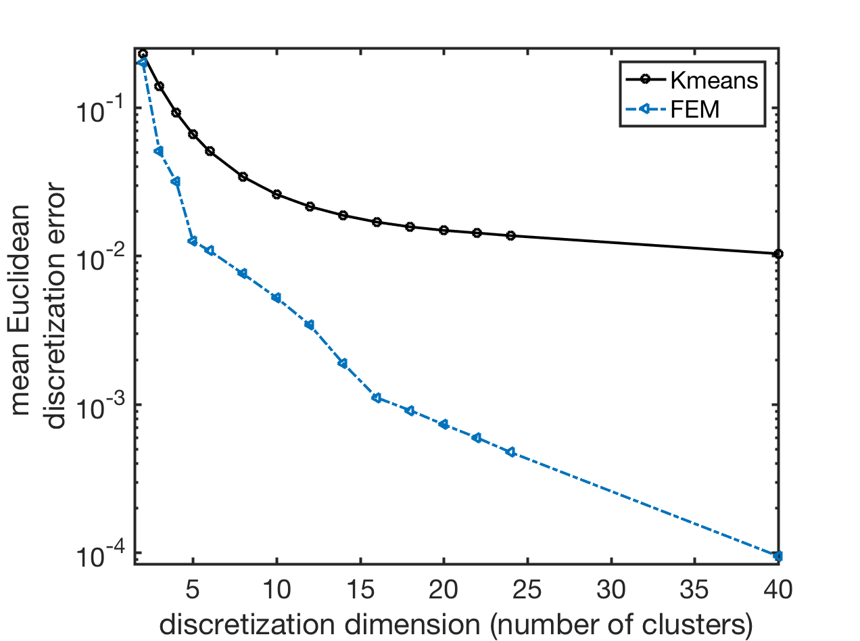
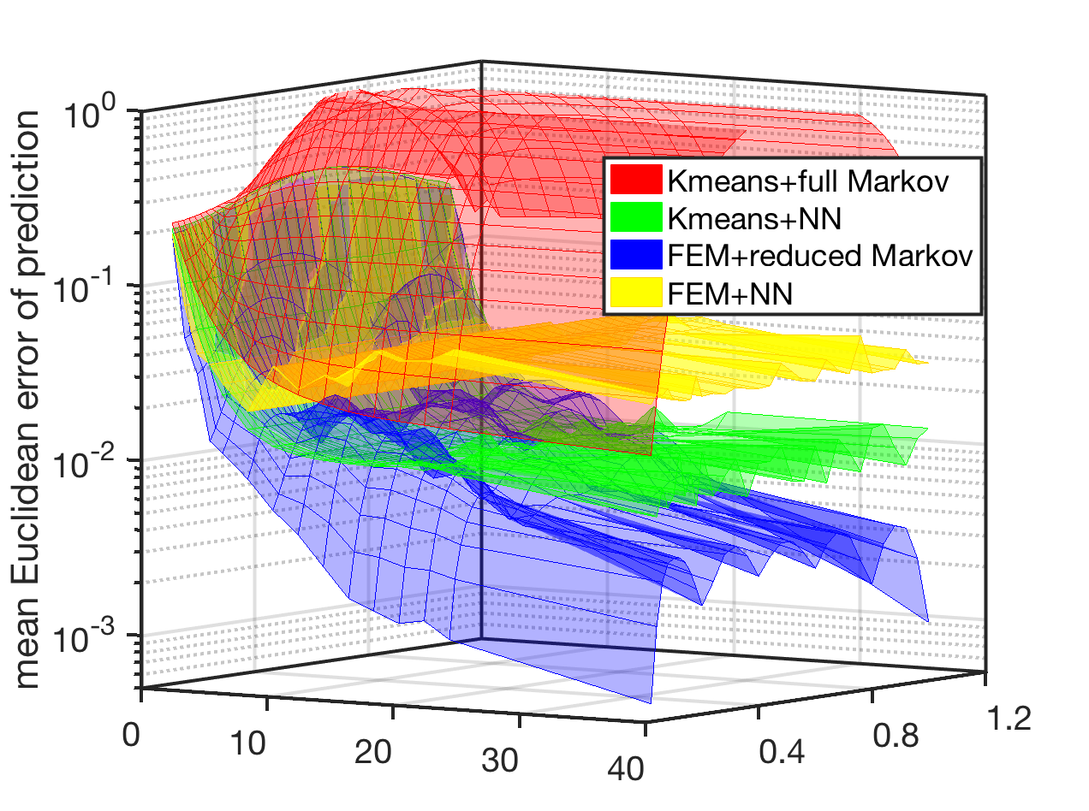
Lorenz-96 Model (“1D turblence“)
F=4 (weakly-chaotic)
discretization error
prediction error
number of Voronoi-boxes
prediction time
Abbreviations
NN: deep learning Neuronal Networks
FEM: FEM-discretization
Kmeans: K-means clustering discretization
Gerber/Pospisil/Navandar/Horenko; in preparation, 2018

Slide 31
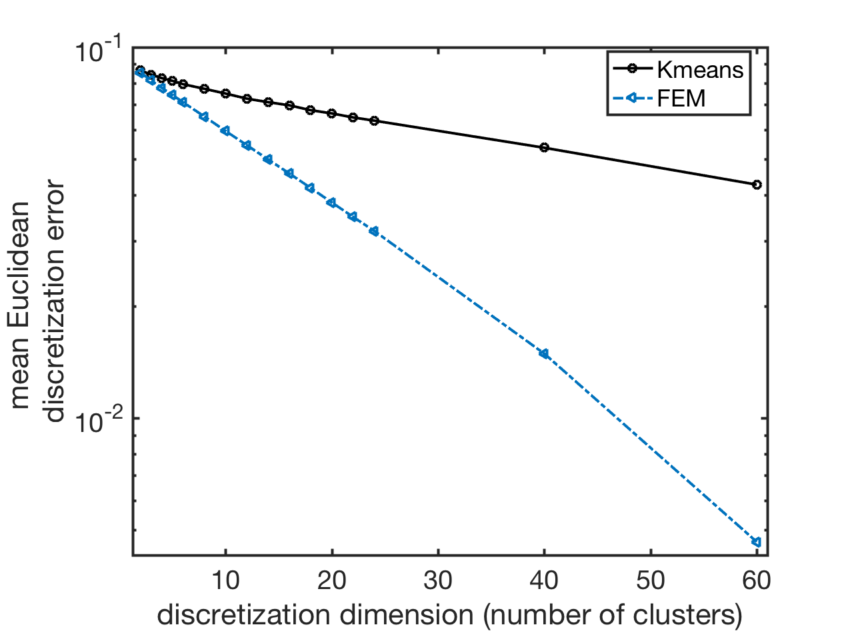
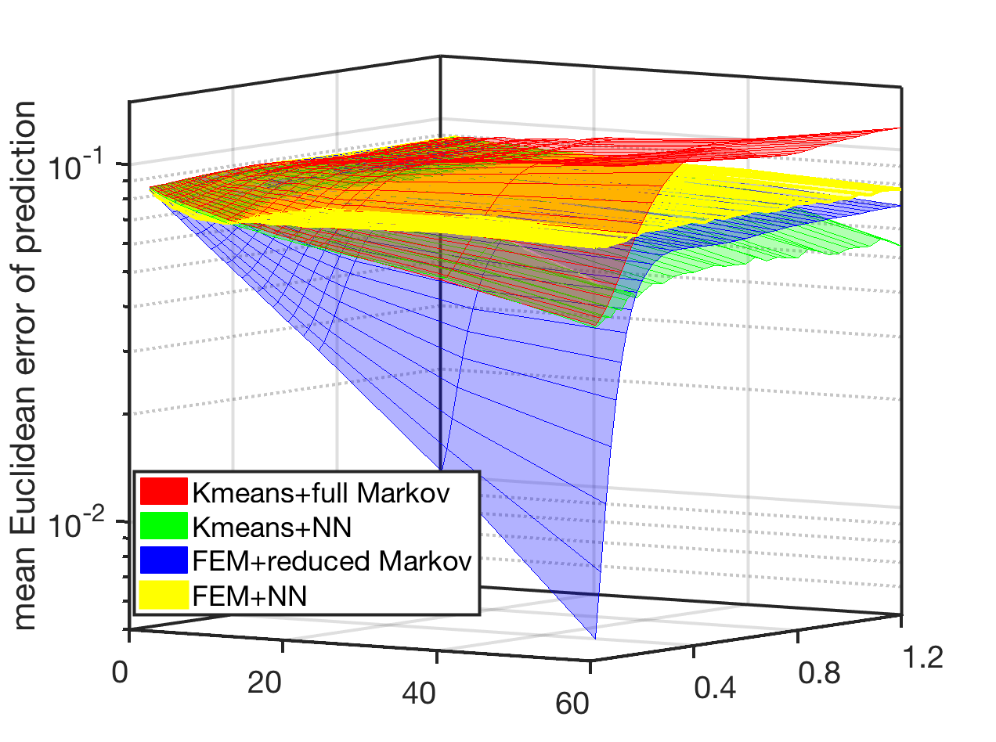
Lorenz-96 Model (“1D turblence“)
F=12 (strongly-chaotic)
discretization error
prediction error
number of Voronoi-boxes
prediction time
Abbreviations
NN: deep learning Neuronal Networks
FEM: FEM-discretization
Kmeans: K-means clustering discretization
Gerber/Pospisil/Navandar/Horenko; in preparation, 2018

Slide 32
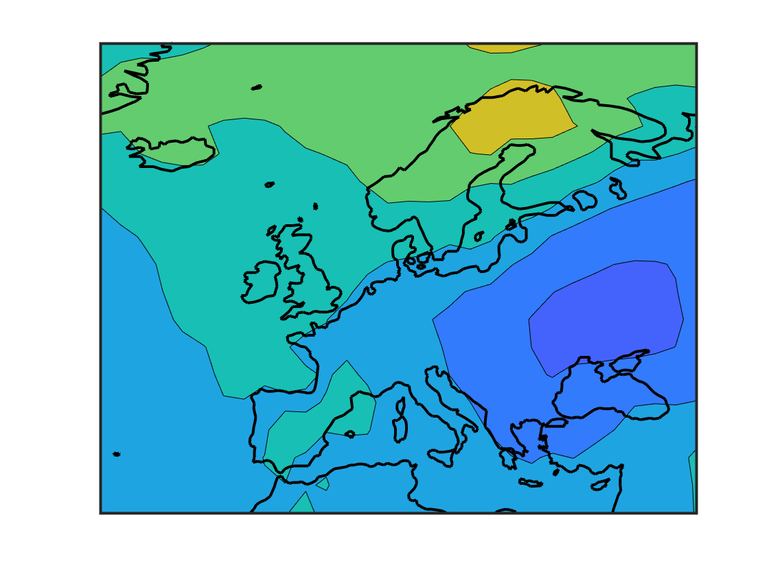
ECMWF re-simulated daily surface temperatures (1979-2010)
Data: temperature deviations from the mean yearly cycle on 20x30 grid over Europe
Takens embedding (3n) to guarantee Markovianity→ 60*3=1‘800 dimensional problem
Abbreviations
NN: deep learningNeuronal Networks
FEM: FEM-discretization
Kmeans: K-means clustering discretization
Gerber/Pospisil/Navandar/Horenko; in preparation, 2018

Slide 33
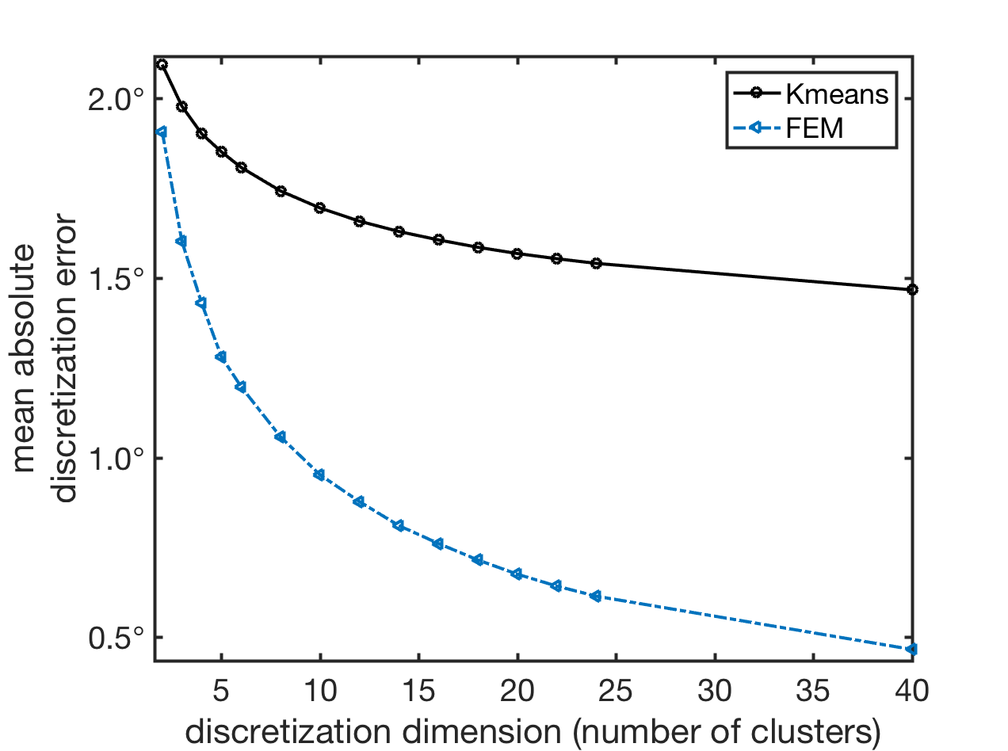
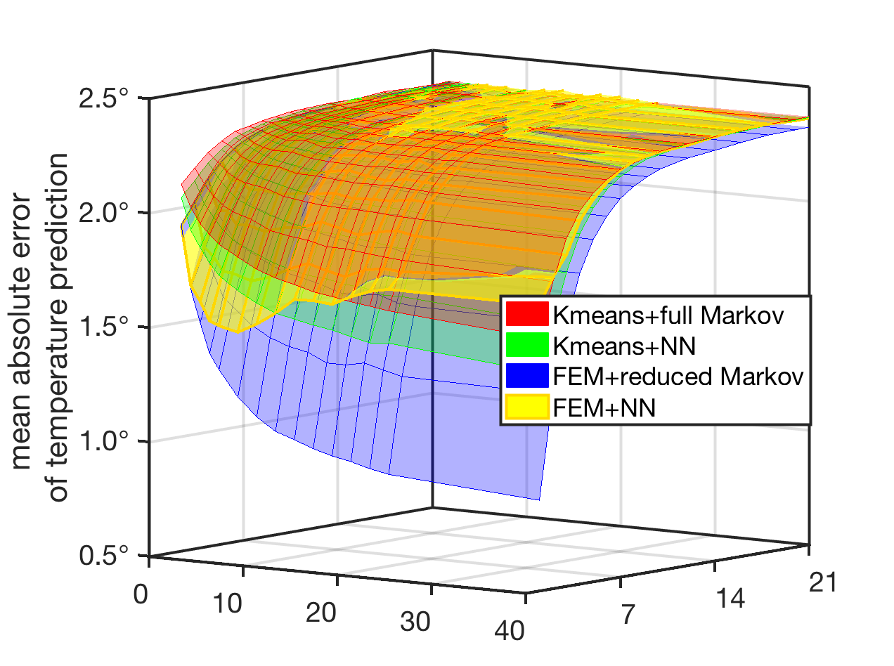
ECMWF re-simulated daily surface temperatures (1979-2010)
Data: temperature deviations from the mean yearly cycle on 20x30 grid over Europe
Takens embedding (3n) to guarantee Markovianity→ 60*3=1‘800 dimensional problem
discretization error
prediction error
number of Voronoi-boxes
days
Abbreviations
NN: deep learning Neuronal Networks
FEM: FEM-discretization
Kmeans: K-means clustering discretization
Gerber/Pospisil/Navandar/Horenko; in preparation, 2018

Slide 34
Discussion
Bayesian/Markov models are – in principle – model-error-free and allow disentangling the errors (discretization error, model error, parameter uncertainty).
Multiscale effects result in latent-effekt Bayesian and Markov models → linear-cost algorithms are available →provide sparse reduced models
L-96 and ECMWF temeperature data illustrate that FEM-discretization combined with latent Markov algorithms allow a drastic reduction of discretization and prediction errors - as compared to the common machine learning tools (K-means, NN and related)
Literature:
[1] S. Gerber, I. Horenko, On inference of causality for discrete state models in a multiscale context,
Proceedings of the National Academy of Sciences of USA (PNAS), 111(41): 14651-14656, 2014.
[2] S. Gerber, I. Horenko, Improving clustering by imposing network information, Science Advances (AAAS),1(7): e1500163, 2015.
[3] S. Gerber, I. Horenko, Towards a direct and scalable identification of reduced models for categorical processes, Proceedings of the National Academy of Sciences of USA (PNAS), 114(19):4863-4868, 2017.
[4] L. Pospisil, P. Gagliardini, W. Sawyer, I. Horenko, On a scalable nonparametric denoising of time series signals, Communications in Applied Mathematics and Computational (CAMCoS), 13: 107-138, 2018.
[5] S. Gerber, S. Olsson, F. Noé, I. Horenko, A scalable approach to the computation of invariant measures for high-dimensional Markovian systems, Scientific Reports, 8: 1796, 2018.
Code in open access: www.GitHub.com/SusanneGerber

