Slide 1
Energy budget-based backscatter in a shallow water model of a double gyre basin
Milan Klöwer^{a,b}, Malte F Jansen^{c}, Martin Claus^{b,d},
Richard J Greatbatch^{b,d} and Sören Thomsen^{b,e}
ª University of Oxford, UK
^{b} GEOMAR Helmholtz Centre for Ocean Research Kiel, GER
^{c} University of Chicago, USA
^{d} University of Kiel, GER
^{e} Pierre and Marie Curie University - Paris VI, FRA
Environmental
Research DTP

Slide 2
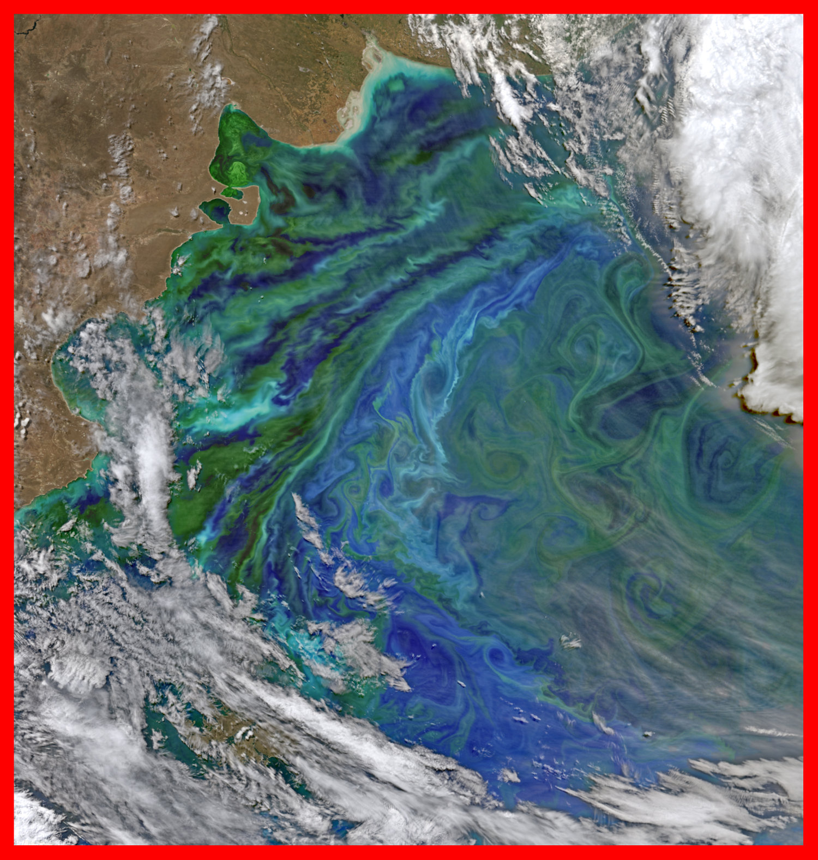
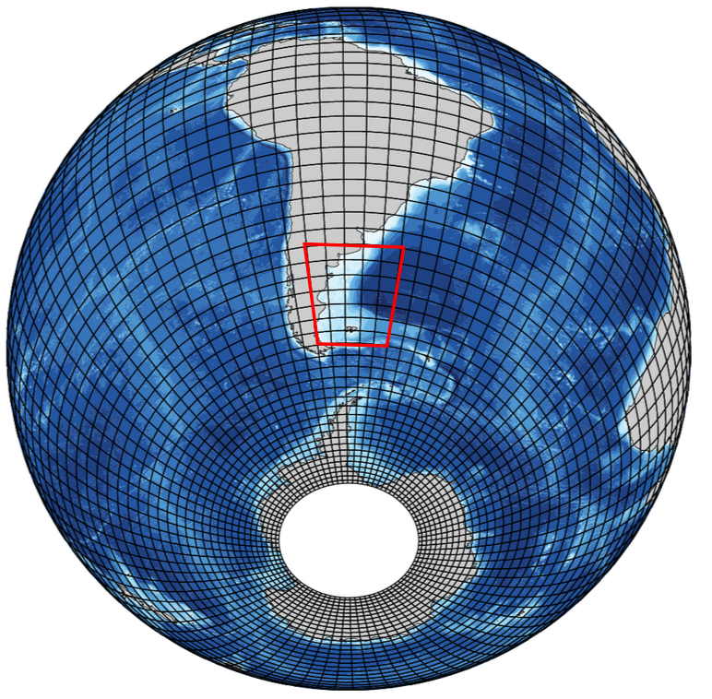
Motivation: negligible sub-grid scale variability?
Typical climate model resolution
of 1°x1°
Satellite image of chlorophyll
with mesoscale structures

Slide 3
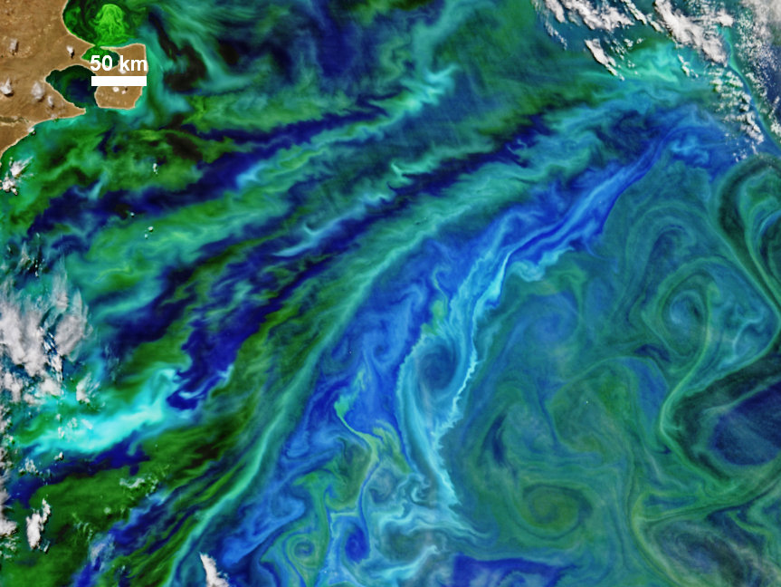
Motivation: What is the role of the unresolved scales?
Mesoscale structures with scales down to 10km or less. From NASA.

Slide 4
Spectrum of 2D geostrophic turbulence
unbalanced flow
balanced flow
k⁻³
Energy / wavenumber
wavenumber k
grid scale
Energy
sources
& sinks
Bottom
friction
Viscosity
Wind

Slide 5
Free-decaying 2D turbulence
time
Balanced flow:
Unbalanced flow:
Inverse cascade
Forward cascade

Slide 6
Spectrum of 2D geostrophic turbulence
unbalanced flow
balanced flow
k⁻³
Energy / wavenumber
wavenumber k
grid scale
Viscosity
air
Used in circulation models
Kinematic viscosity
water

Slide 7
Energy budget-based backscatter - the idea
Resolved flow
Eddy kinetic energy
Bottom friction
Wind forcing
Viscosity
unbalanced
flow
balanced
flow
Backscatter
Dissipation
Backscatter parameterisation
sub-grid
Eddy kinetic energy
Diffusion

Slide 8
Energy budget-based backscatter - the idea
Viscosity
Backscatter
unbalanced flow
Dissipation
balanced flow
Sub-grid
Eddy kinetic energy
Budget
Backscatter
parameterisation
Diffusion
Backscatter is realised with negative viscosity

Slide 9
Test case: An idealised North Atlantic
Shallow water model
Prognostic variables
Westerlies
Easterlies
H = 500m
Wind-driven ocean circulation
+ Eddies
What is the true solution for circulation in such a basin?
How would a model simulate the circulation?

Slide 10
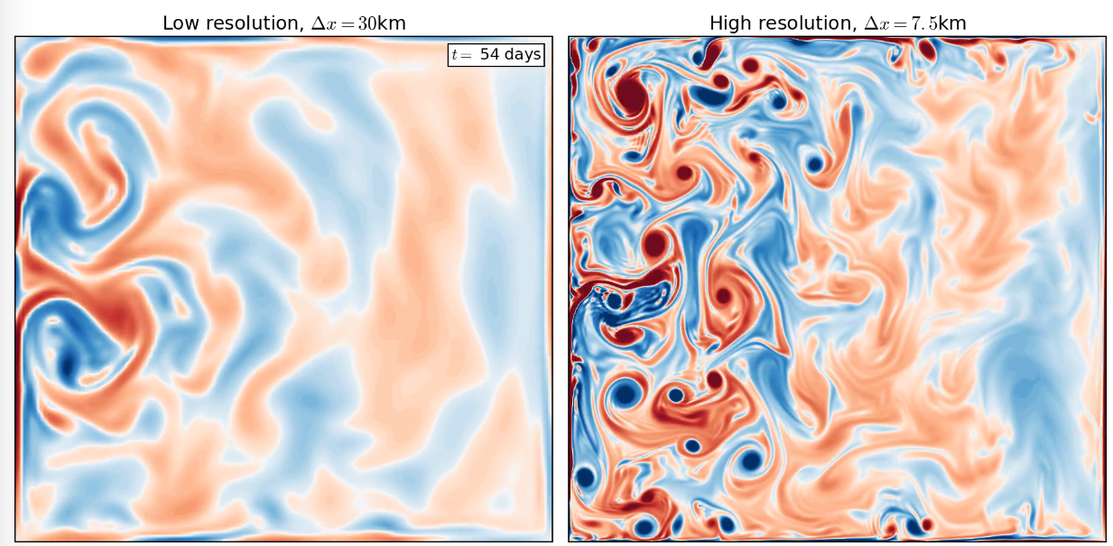
Simulated vorticity dynamics at different resolution
128² grid cells
512² grid cells
Viscosity
Total cpu time for 30years: 6hours
12.5days

Slide 11
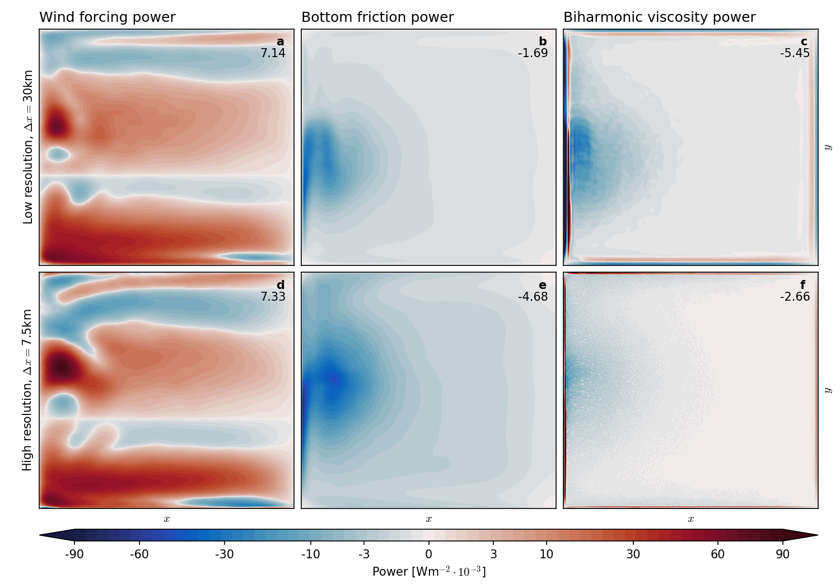
What’s actually wrong? The energy cycle.
Only 24% energy dissipated through bottom friction, 76% through viscosity
Should be: 66% vs 35%
Too much energy is dissipated at the grid scale

Slide 12
Energy budget-based backscatter: The method
Biharmonic diffusion operator
Energy equation of the shallow water system
Bottom friction
Viscosity
Wind
Introduce sub-grid EKE equation
where
Backscatter forcing is then

Slide 13
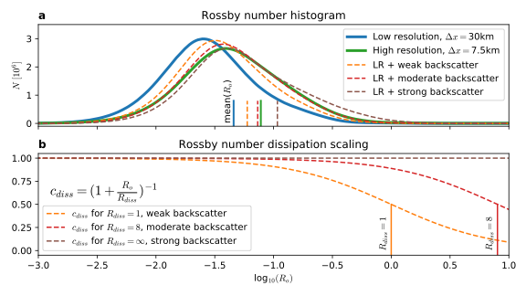
Rossby number-dependent dissipation scaling
is a cut-off Rossby number and controls the strength of the backscatter

Slide 14
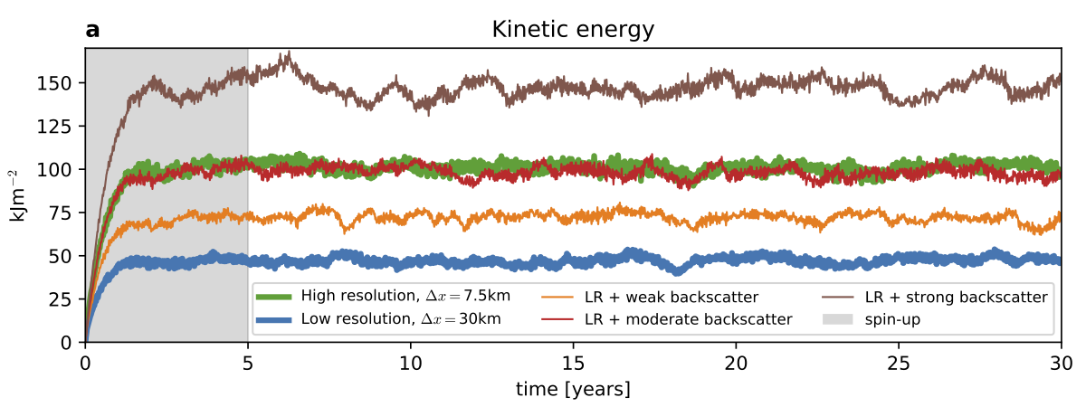
List of model runs
How to tune the model:

Slide 15
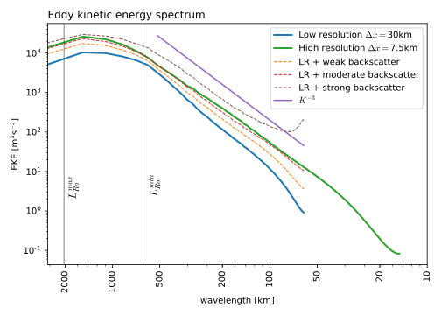
Results - spectrum
Backscatter with Rossby number dissipation scaling increases EKE levels on all scales.

Slide 16
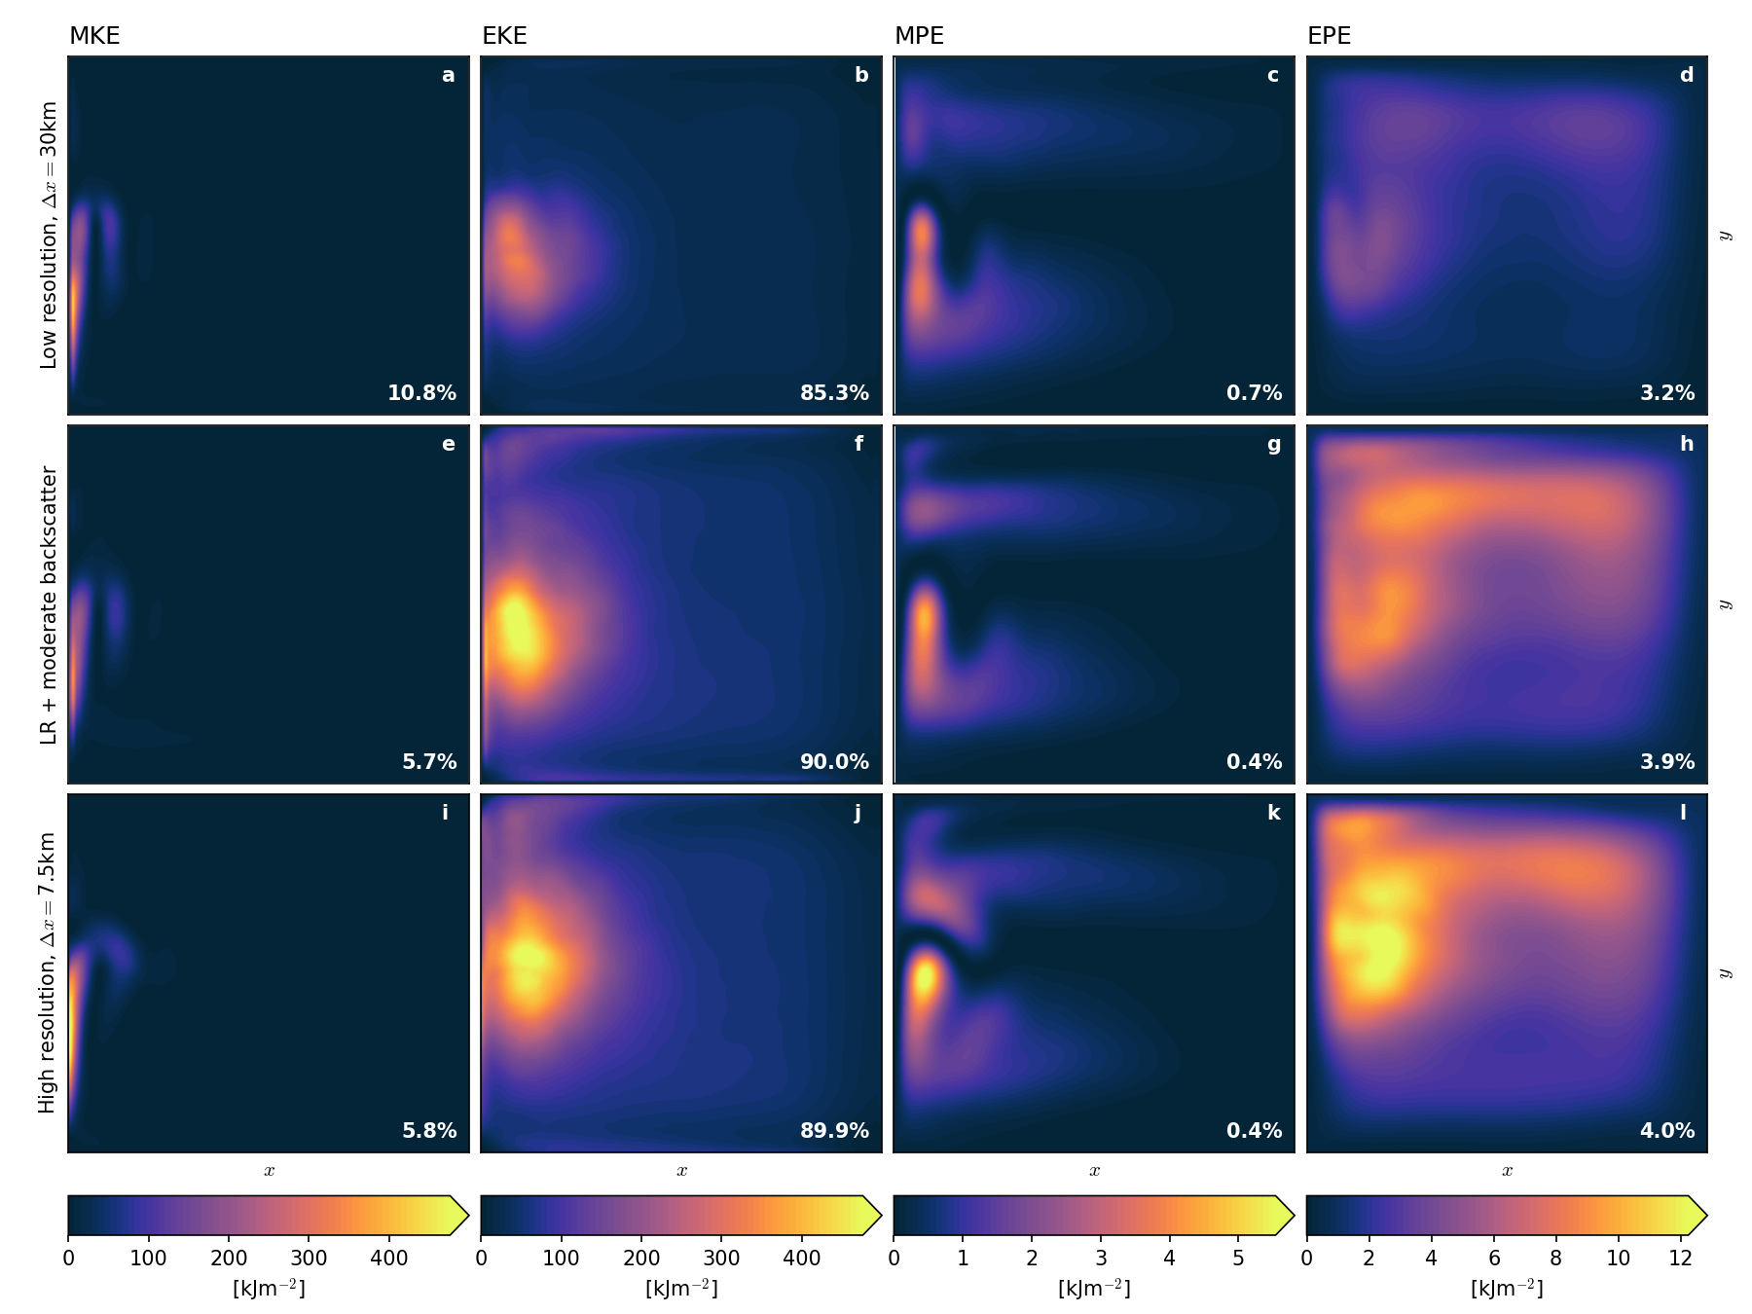
Results - where is the additional energy?
Backscatter increases EKE and EPE levels correctly.

Slide 17
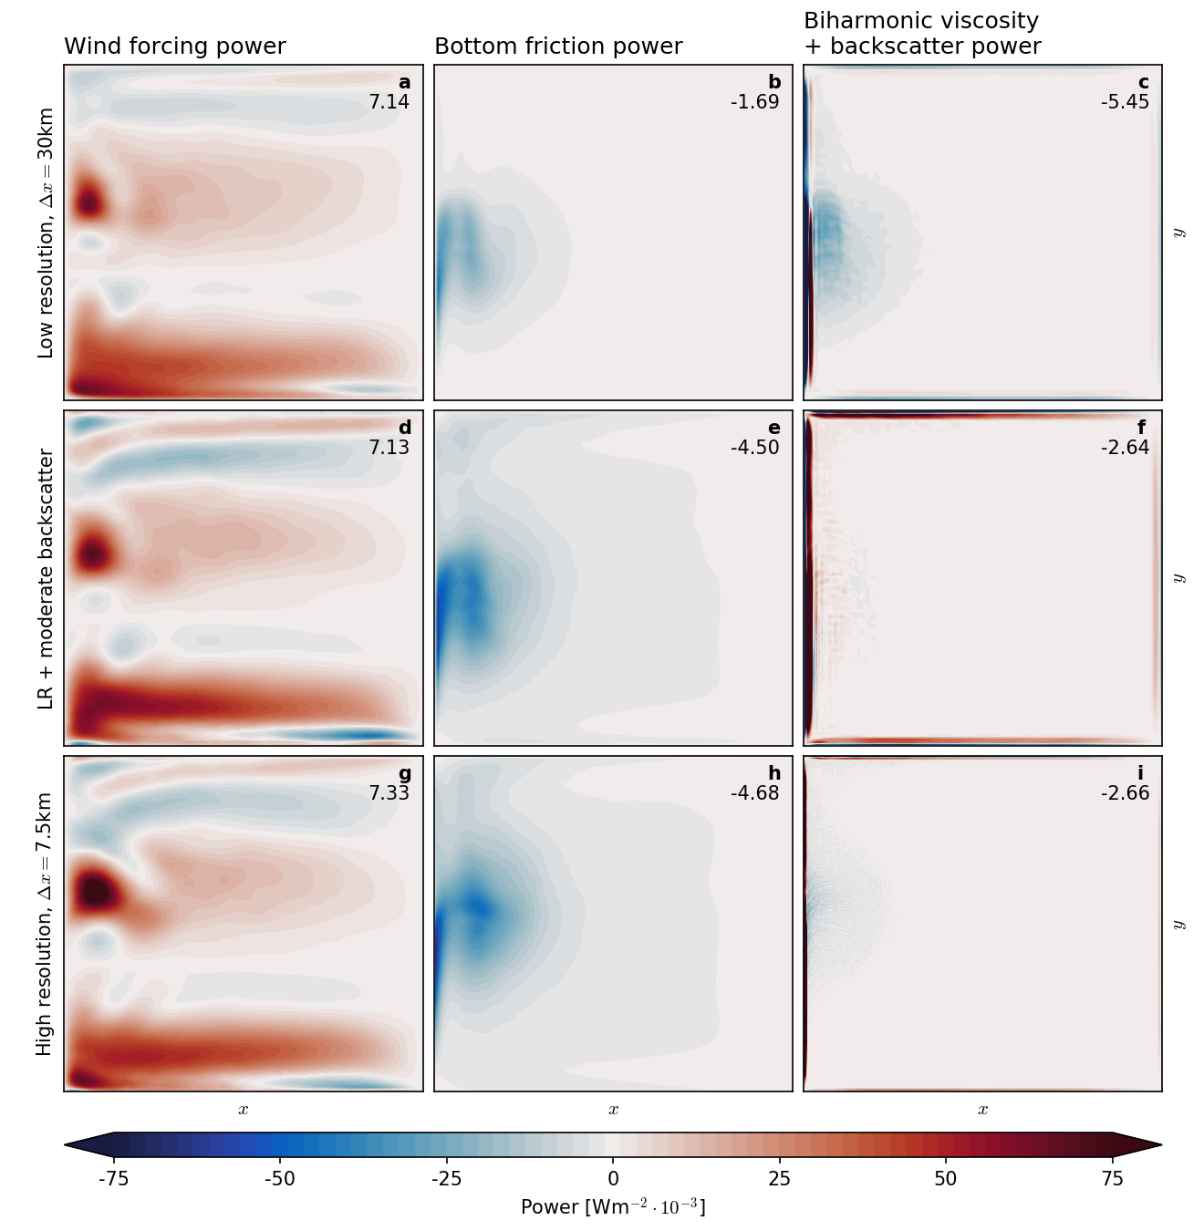
Results - energy cycle
Backscatter corrects the energy cycle. Most dissipation is through bottom friction.

Slide 18
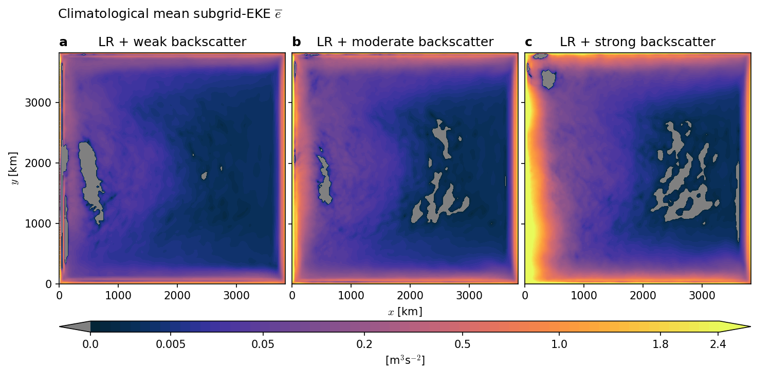
Sub-grid EKE
Double gyre basin: Backscatter is a forcing at the boundaries & in the turbulent regions.

Slide 19
Results - vorticity dynamics
Backscatter intensifies eddies and creates new ones.

Slide 20
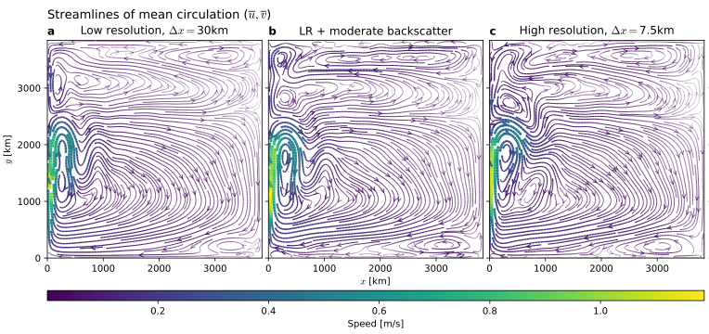
Results - mean circulation
Correcting the energy cycle also corrects the mean circulation.

Slide 21
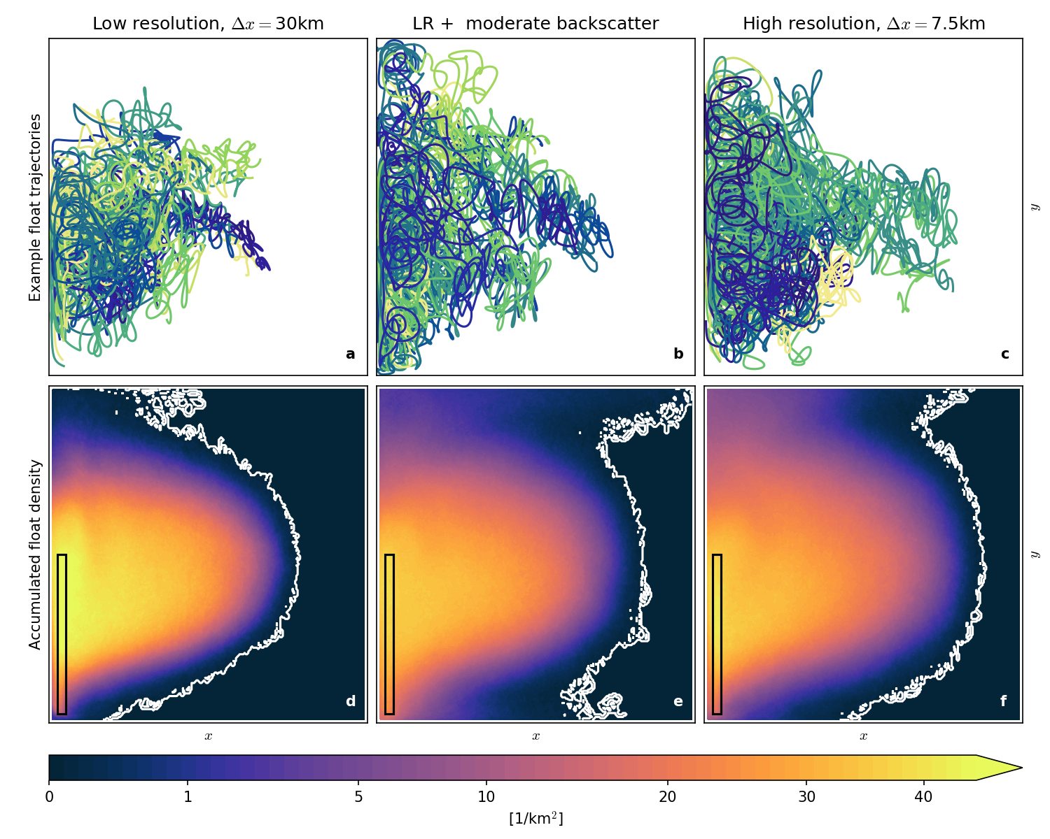
Results - float trajectories
Backscatter allows floats to move against the mean current.

Slide 22
Take home messages
Viscosity in circulation models is far from reality.
The energy cycle is distorted.
Energy budget-based backscatter lets you
Keep track of sub-grid eddy kinetic energy.
Re-inject energy to the resolved flow.
A better simulation at low resolution!

Slide 23
Take home messages II
Shallow water model written in python
/milankl/swm
Under review
Klöwer, M, MF Jansen, M Claus, RJ Greatbatch, S Thomsen, 2018. Energy budget-based backscatter in a shallow water model of a double gyre basin. Ocean Modelling.
milan.kloewer@physics.ox.ac.uk

Slide 24
Energy budget-based backscatter: The method II
Harmonic backscatter operator
Energy equation of the shallow water system
Introduce sub-grid EKE equation
Then

